Slide 1
Microprocessor Basics
J. Yankey

Slide 2
Definition
An integrated circuit that contains all the functions of a central processing unit of a computer
A microprocessor incorporates the functions of a computer central processing unit on a single integrated circuit.
The microprocessor is also known as the CPU or the processor

Slide 3
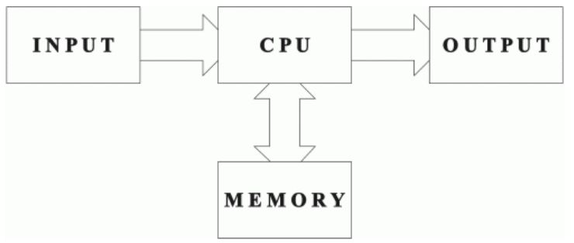
Microprocessor System

Slide 4
Input / Output
I/O devices are the means by which a computer system communicates with an external environment (the real world).
These I/O devices must present to the computer a digital interface, known as an I/O port.
These ports are similar to memory in that each port appears to the CPU as a set of storage cells, normally of the same width as the memory.

Slide 5
Busses
The CPU communicates with memory and peripheral devices along a set of signal lines referred to as the bus(the external bus).
A bus is a common group of wires that interconnect components of a computer system.
The CPU partitions these signal lines into address, data and control buses that connect the CPU with the other circuitry of the computer

Slide 6
Busses
The address bus requests a memory location from the memory or I/O location from I/O device.
When memory is addressed the address bus contains a memory address which varies in width with the different versions of the microprocessor
The data bus width transfers information between the microprocessor and its memory and I/O address space.
Data transfer vary in size, from 8 bits wide to 64 bits and more in various members of the Intel microprocessor family.

Slide 7
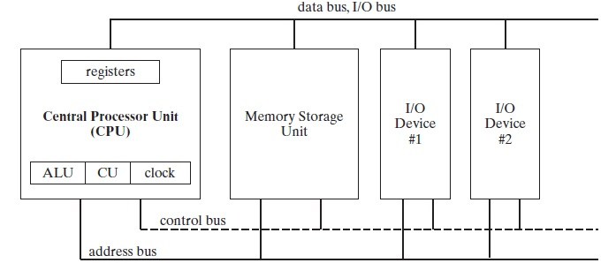
General Microprocessor overview

Slide 8
Components of a microprocessor
The CPU consists of
Registers
Arithmetic/Logic Unit(ALU)
Control Unit
These units are connected by busses(The internal bus).
The internal busses allow data and control signals to be passed between these units

Slide 9
Registers
Registers are high-speed storage locations directly inside the CPU, designed to be accessed at much higher speed than conventional memory.
The general-purpose registers are primarily used for arithmetic and data movement.
Portions of some registers can be addressed as lower 16-bit or 8-bit values.
For example, the EAX register has a lower 16-bit AX part, while the AX register, has an 8-bit upper half named AH and an 8-bit lower half named AL.

Slide 10
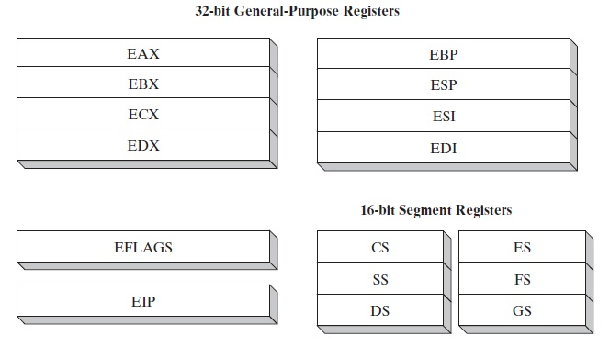
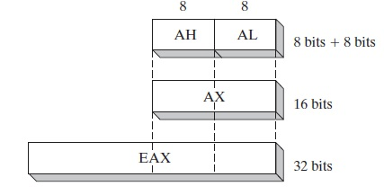

Slide 11
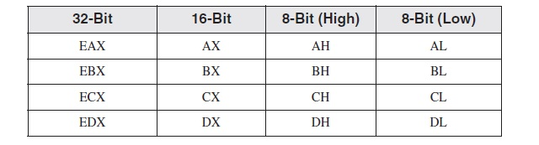
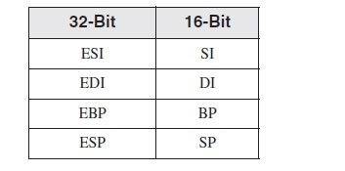
All ..X general purpose registers can be expressed in the same formats shown for EAX previously.
The remaining general-purpose registers can only be accessed using 32-bit or 16-bit names

Slide 12
Special-purpose general-purpose registers
EAX: Used for multiplication and division instructions.
ECX: Used by the CPU as a counter in loop instructions (automatic)
ESP: Used to point to the stack
ESI and EDI: Used for high speed memory transfer instructions.
EBP: Points to a memory location on the stack. Usually used by high level languages.
The EIP: stores the address of the next instruction to be executed.

Slide 13
The Arithmetic Logic Unit
The ALU is a complex combinational circuit that is used within the CPU to perform logic and arithmetic operations on the contents of registers.
The output of the ALU is directly connected to a bus.

Slide 14
Control Unit
The control unit decodes and monitors the execution of the instruction.
The control unit does not execute instruction but directs other parts of the system to do so.
The control unit acts like an arbiter since various parts of the system compete for the resources of the CPU.

Slide 15
Operations of the Microprocessor
The first stage of the processing cycle is the fetch cycle.
The execute cycle forms the second stage of the processing cycle. The operations of the control logic are now dependent upon what instruction pattern is being applied to its inputs.

Slide 16
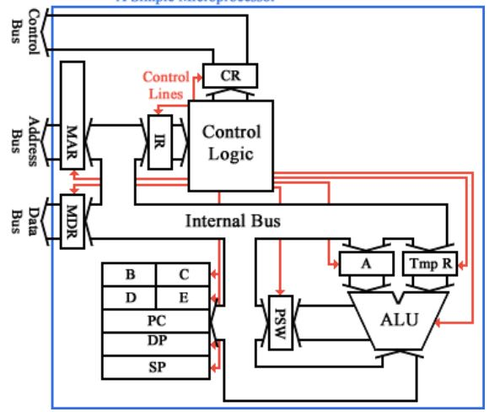
Operations of the Microprocessor

Slide 17
Operations of the Microprocessor
The following special purpose registers are used
Memory Address Register, Memory Data Register ,
Instruction Register, Program counter, Accumulator,
Control Register, Data pointer, stack pointer,
Processor status word and general registers.

Slide 18
Microprocessor instructions
The instruction to be performed
The source of the data
The source of the second data item
The destination of the resultant data
The next instruction

Slide 19
Microcycles
The execution of instruction is made of small operations known as micro-operations or microcycles.
Data transfer operation: destination source
Register Manipulation Operation : destination <- expression

Slide 20
Microcycles
Points to note
If a microcycle involves a transfer between two of the internal registers, only that can occur within one clock cycle.
If a microcycle involves register manipulation, however, or uses the external memory or address buses, then it can occur at the same time as a register transfer.

Slide 21
Microcycles
Example
take the instruction "Add the contents of the accumulator to the contents of memory location 2100, and leave the result of the addition in the accumulator."

